Slide 1
Finding Funds
For Oregon Students
Presenter:
Date:

Slide 2
Key
Topics
Financial Aid Terms
FAFSA/ORSAA
Grant Programs
Scholarship Applications
Notes:
Notes:
The goal of this presentation is to understand college costs and how you might be able to pay for them. In order to do that we are going to cover some basic financial aid terms, quickly review the FAFSA/ORSAA, dig into OSAC grant programs, and finally discuss scholarships!
If you want additional information about many of these topics you can find videos on our YouTube page.

Slide 3
quick tips for
Getting Started
Stay Organized
Legal Name
Email
Store usernames, passwords, deadlines
Use your legal name on all applications
Use professional email and check it
Notes:
Notes-
Securing financial aid can be tricky, but the better prepared you are the easier it will be for you get money for college:
Stay Organized- Use a document, like the ASPIRE Student Tracker, or a calendar, to keep track of your usernames, passwords, and deadlines. Use a phone or paper calendar to keep track of upcoming deadlines
Legal Name- FAFSA requires the legal name on a social security card. Failure to use this legal name can cause rejection/complication issues.
Legal names on an ORSAA help ensure we have the most accurate information possible for students – be sure to use the same name on your FAFSA/ORSAA as you do with your college applications, admissions records, and financial aid applications. This reduces risk of errors.
Email- Make sure to use a permanent, professional email address on applications and get in the habit of checking it regularly. DO NOT use a school/work email for your accounts. Many scholarships will only communicate with you via email and if you fail to check your email you might lose money that was originally awarded to you.

Slide 4
get to know different ways to
Pay for College
Grants
Scholarships
Work Study
Loans
Funding Source:
Federal and State
Details:
Need-based
No repayment
Funding Source:
Privately funded
Details:
No repayment
OSAC, local, national
Funding Source:
Federal
Details:
On & off campus employment
Funding Source:
Federal & Private
Details:
Must be repaid with interest
Notes:
Notes:
Grants are usually funded by either the state or federal government. State grants include the Oregon Opportunity Grant, Oregon Promise Grant, Oregon Tribal Student Grant, and the Oregon Student Child Care Grant. Federal grants include the Federal Pell Grant (operated by Department of Education) and Chafee Education and Training Grant (though Chafee is operated on a state-level, it is funded by the federal government). Grants do not need to be repaid and primarily awarded based on financial need. Grants applications can be found at OregonStudentAid.gov. Many grants require a student to be enrolled at least half-time and maintain satisfactory academic progress.
Scholarships: Nationally, OSAC is unique in its public-private partnership with donors, offering more than 600 scholarship opportunities for Oregon students. More than 3,700 awards totaling over $17 million are distributed annually, and a simple scholarship application process allows students to apply to these using a single application. It is this “one-stop shopping” scholarship process that makes it easy for students to apply using one common application. Scholarships do not need to be repaid. Many other community, private, and institutional scholarships have their own application processes.
Work Study is a federal program that helps students earn financial funding through a part-time work program. These job opportunities are specifically intended for students, so the work schedule will prioritize a student’s class schedule. These roles are typically need-based aid and often require a FAFSA. Different schools will have different work-study options available.
Loans MUST be repaid. Because loans obligate future income, they should be the last option that students and their families utilize to finance education. Students who need to rely on loans should always borrow the minimum necessary amount. A tip about Federal Student Loans should be looked at before private loans because of interest rates, payment plans, etc?

Slide 5
Cost of
Attendance
Cost of Attendance
(COA)
“Sticker Price” to attend a college
Average college costs including tuition, fees, books, misc. and living expenses
It is NOT your bill
Costs can vary from school-to-school
Used to determine a student’s financial need calculation
Notes:
Notes:
Cost of Attendance is not what students and families should expect to pay, think of it like a “estimated sticker price” for college or an average price to attend a particular college. The actual cost to attend college will depend on different circumstances like financial aid and living situations.
The Cost of Attendance will differ from school to school because the cost to got to PCC is different then the cost to attend Lewis and Clark or PSU.
COA is used to determine a student’s financial need calculation.
A Cost of Attendance (COA) document for the school year is available on HECC website which includes Oregon community colleges, Oregon public universities, and most Oregon-based private non-profit colleges. You can also find a COA list in the ECMC booklets or on institutions websites or via catalogs.

Slide 6
Expected Family
Contribution
Expected Family Contribution
(EFC)
A number used to determine your eligibility for financial aid
Determined by data reported on the FAFSA/ORSAA
It is not your bill
EFC does not change from
school-to-school
Used to determine a student’s financial need calculation
Notes:
Notes:
Just like with COA the Expected Family Contribution is not what a student or family should expect to pay to attend a particular college. The EFC is also not the amount of aid student will receive – it is a calculation made from the federal formula in the FAFSA and ORSAA.
EFC does not change from one institution to another; however, the type of aid/amount each institution offers may vary.
Completing FAFSA/ORSAA early and completing any required paperwork at each institutions FAO will ensure early award offers for students/families to compare before deciding.

Slide 7
Financial
Need
Financial Need
A formula used to determine the amount of need-based aid you can receive
COA - EFC = Financial Need
Cost of Attendance – Expected Family Contribution = Financial Need
You cannot receive more need-based aid than the amount of your financial need
Notes:
Notes:
Financial Need is essentially a formula colleges use to determine the amount of need-based aid you can receive. In simple form Financial Need is COA-EFC, in reality it is a little more complicated but for our purposes this definition will work.
Financial Need will differ based on the COA of the college you are attending. For example, you might have a higher financial need at a private college or public university then you would at a community college. Additionally, not all students will have Financial Need. Sometimes you hear Financial Need referred to as unmet need.

Slide 8
Overview
FAFSA/ORSAA
FAFSA:
Opens Oct 1
U.S. Citizens or eligible non-citizens
Used to access Federal and State financial aid, and many scholarships
FAFSA
ORSAA
ORSAA:
Opens Oct 1
Oregon students who are undocumented, or have DACA/TPS status
Used to access state financial aid, and many scholarships
Only File 1
If you are unsure which form to complete use the OSAC FAFSA/ORSAA filter tool
Notes:
Notes-
FAFSA- Stands for Free Application for Federal Student Aid
ORSAA- Stands for Oregon Student Aid Application
Both the FAFSA and ORSAA are free applications and students should never pay to complete these forms
Many scholarship and grant applications, including the OSAC scholarship require completing a FAFSA or ORSAA application. Scholarships may require a FAFSA or ORSAA even if it’s not a need-based scholarship.
Both the FAFSA and the ORSAA open on Oct 1st, but students only need to complete one of the applications. Complete the FAFSA if you are a U.S. Citizen or eligible non-citizen and complete the ORSAA if you are undocumented, have DACA, or TPS status. If you are unsure which form to complete you can use the quiz on the OregonStudentAid.gov website.
International students or those with a valid visa are not eligible to submit either application.

Slide 9
The OSAC
Create a Student Account
Student Portal
Applications and Awards:
Oregon Promise Grant
Chafee Grant
Child Care Grant
Oregon Tribal Student Grant
OR National Guard State Tuition Assistance
OSAC Scholarships
OregonStudentAid.Gov
Notes:
Notes-
The OSAC portal is where students can apply for a variety of grants and scholarships administered by the State of Oregon. OSAC recommends students create a portal account as soon as possible so that they are ready for the scholarship/grant application process.
Students are encouraged to check their email and portal account regularly during the spring to check for any award notifications.

Slide 10
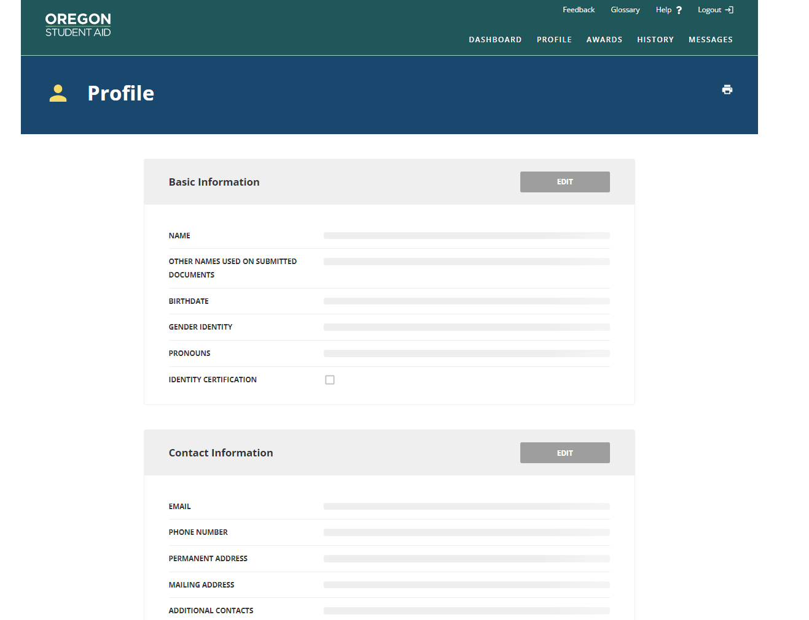
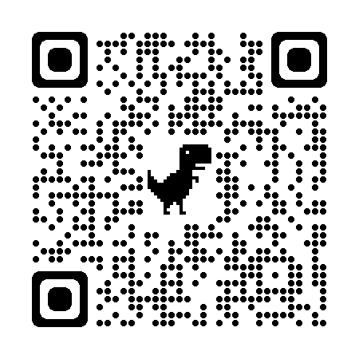
creating an
OSAC Portal Account
Use your legal name, make sure it is the same name as the one on your FAFSA/ORSAA
Password must be 12 characters including digits, upper case letter, lower case letter, and symbol (e.g. @$%)
https://app.oregonstudentaid.gov/
Notes:
Notes-
Creating an OSAC portal account is easy, but a few things can be tricky.
Make sure to use your legal name and the name that matches your FAFSA or ORSAA application
Remember your password is 12 characters and has specific requirements
Students should sign up with a personal email account, not a high school or college-operated email account, so that they will have access to their portal account indefinitely. Students are encouraged to check their email and portal account regularly during the spring to check for any award notifications.
Remember to stay organized, it is hard to reset a username and password so make sure to keep track of your username and password

Slide 11
getting to know the
Oregon Opportunity Grant
Supports undergraduate students at eligible Oregon colleges
Maximum award for
2022-23 (full time)
Community College- $3,600
4-Year Institution- $4,692
Open to all Oregon residents who meet EFC limit and FAFSA/ORSAA deadline
No additional application, students only need to file a FAFSA/ORSAA as soon as possible after October 1
Notes:
Notes:
Oregon Opportunity Grant is Oregon’s largest need-based grant program for Oregon students planning to go to college. Students are eligible to receive this grant up to four years.
Eligibility:
Open to Oregon residents who attend an eligible postsecondary school in Oregon
Haven’t already earned a baccalaureate degree
Enrolled at least half-time (award will be prorated for half-time enrollment)
Maintain satisfactory academic progress
Priority goes to those with financial need
Must meet EFC limit and FAFSA/ORSAA cutoff date
Additional eligibility requirements for ORSAA students (must meet tuition equity requirements)
File the FAFSA/ORSAA: all FAFSA and ORSAA filers are automatically considered for the Oregon Opportunity Grant and will be notified of their award via email.
File as soon as possible once it opens on October 1. OOG funds are awarded until funds are depleted. 2023-23 FAFSA/ORSAA cutoff is July 31, 2022 (as of September 2022)
List an eligible Oregon school on your FAFSA/ORSAA
Resolve any errors as quickly as possible, OSAC cannot award OOG to FAFSA/ORSAA with error codes
OOG is not available for out of state and for-profit schools
OOG does not award funds for summer quarter
Priority: goes to those with financial need, based on the applicant’s EFC. Applying does NOT guarantee an award.
The EFC limit for 2022/23 is $8,000 (increase over several previous years at $3,500).
Funds are only disbursed for the fall, winter, and spring terms each year. OOG does not disburse grant funds during the summer.

Slide 12
getting to know the
Oregon Promise Grant
Helps pay tuition costs at an Oregon Community College
Must begin community College immediately, within 6 months of HS/GED® graduation
$
New HS or GED® test graduates
2.0 cumulative GPA
145+ on all GED tests
EFC may be considered, and EFC criteria is subject to change
Notes:
Notes:
Oregon Promise helps pay tuition at an Oregon community college up to 90 credits for recent high school and GED test graduates
Eligibility:
Be a recent Oregon high school graduate or Oregon GED Test graduate
Have documentation for a cumulative high school GPA of 2.0 or higher (or pass all GED tests). Transcript is either provided by student or though the high school registrar completing the GPA verification process in the OSAC partner portal.
Be enrolled at least half-time at an Oregon community college within 6 months of high school graduation or GED completion (typically the next college term excluding summer)
Be an Oregon resident for at least 12 months prior to college attendance
Keeping Eligibility:
Maintain good satisfactory academic progress with community college
Be enrolled in at least 6 credits per term
Have no gaps in enrollment (except summers)
No more than 90 college credits attempted or completed (includes credits attempted while in HS and dual enrollment)
Submit FAFSA/ORSAA by June 1 each year
EFC Disclaimer:
Your eligibility may be determined by your Expected Family Contribution (EFC) and this criteria is subject to change. The EFC limit would typically be much higher than the limit for the OOG or Federal Pell Grant. OSAC encourages all interested students to apply by their deadline, regardless of their income level or EFC. EFC limits are determined in the spring prior to the new academic year.
Even if there is a tentative EFC limit set and the application is still open, STILL APPLY. The application will not stop a student from submitting their application if they are over an EFC limit since the EFC limit can change later after the application closes when OSAC re-evaluates total applicant pool and available funds.

Slide 13
more information about the
Oregon Promise Grant
How to Apply:
File your FAFSA/ ORSAA, list an Oregon Community College
Complete the Oregon Promise application in the OSAC Student Portal
Amount:
In 2022-2023
Full-time students: $2,000-$4,128
Oregon Promise award amount depends on several factors
Notes:
Notes:
OSAC encourages every eligible student to apply for the Oregon Promise, even if they feel confident that they will not be attending an Oregon community college. Students who are unsure of their postsecondary plans should definitely be applying.
For full-time students, awards range from $2,000 for the year up to the average cost of tuition across all community colleges at 12 credits per term. Students’ award amount depend on their financial need and other state and federal grants that they have been awarded, as the grant is a “last dollar grant”. For 2022-23, the maximum award amount will be $4,128.

Slide 14
deadlines
Oregon Promise Grant
I am graduating from: | I am graduating during this time: | Deadline to complete both: Oregon Promise App and FAFSA/ORSAA | You must start community college by this term:
High School or Home School | March 1 – June 30 | June 1 | Fall
 | July 1 – Nov. 30 | Nov. 1 | Winter
 | Oct. 1 – Feb. 29 | Feb. 1 | Spring
GED® Program | March 1 – June 30 | July 10 | Fall
 | July 1 – Nov. 30 | Dec. 10 | Winter
 | Oct. 1 – Feb. 29 | March 10 | Spring
You must apply DURING senior year before graduation
or immediately after GED® test completion
Notes:
Notes:
Most students (high school seniors graduating in May or June) will have an Oregon Promise deadline of June 1. This means that students should complete their application and FAFSA/ORSAA before graduation. High school students graduating in May or June only need at least one term of completed senior grades to be reviewed for the grant.
GED Test graduates must submit immediately after completing their fourth and final test.
The application for students graduating between July 1, 2022 – and June 30, 2023 will open October 1.

Slide 15
other
OSAC Grant Programs
Chafee Training Grant:
For foster youth under 26 years old
Student Child Care Grant
For students with children age 12 and under
Oregon Tribal Student Grant:
For members of Oregon’s Federally recognized tribes
Barber & Hairdresser Grant
For students with financial need attending participating programs
Oregon National Guard
State Tuition Assistance
For current and drilling members of Air/Army Guard
Deceased/ Disabled Public Safety Officer Grant
For dependents of officers harmed in the line of duty
Notes:
Notes:
Chafee Education & Training Grant: federal grant (FAFSA required) for current and former foster youth under 26 years old
Funding: Award amounts may vary and will be awarded based on availability of funds. Students can use funds for up to 5 years of postsecondary education or until the term in which they turn 26, whichever comes first. The program is federally-funded, but OSAC disburses the funds and foster status is confirmed by the Oregon Dept of Human Services: https://www.oregon.gov/dhs/
Application is available in the Student Portal from November 1 to March 1.
Eligibility: currently be in child welfare foster care OR had been in child welfare foster care for at least 180 days after your 14th birthday and exited substitute care at age 16 or older OR be a former foster youth who was adopted or entered into a guardianship on or after your 13th birthday AND your adoption/guardianship was finalized after 9/1/15. Must also be enrolled at least half-time and maintain satisfactory academic progress.
Oregon Tribal Student Grant: A state grant, FAFSA or ORSAA required for individuals who are members of one of Oregon’s Federally recognized tribes
Funding: Award amounts vary, but will cover up to the cost of attendance at Oregon Public institutions for students pursuing their first Associate, Bachelor’s, or Master’s degree
Application: Priority deadline to apply is Aug 1st, additional application dates will be announced if funding allows
Eligibility: Must be an enrolled member of one of Oregon’s 9 Federally recognized tribes
Note: This grant is currently funded for the 22-23 academic year. Future funding will depend on the legislature
ONGSTA
Overview: To provide funding for tuition (at in-state residency rates) for Oregon community colleges (up to 90 credits) and public universities (up to 180 credits) for current Oregon National Guard members.
Guard Qualifications: Complete any military basic training, be currently drilling, have a current passing Annual Physical Fitness Test (APFT) score, be a member of the Oregon National (air or army) Guard, and not currently the subject of any adverse actions.
Education Qualifications: Not have achieved a prior baccalaureate degree, not be default/owe a refund on any federal Title IV loan, be enrolled and in good standing in an associate/baccalaureate degree program at an eligible Oregon institution, accept any other federal and state grants offered, and complete your guard-specific tuition-assistance application. (The GI Bill is not considered in the ONGSTA calculation.)
Application Deadlines: Sept 1 (fall term), Nov 1 (winter term), Mar 1 (spring term), June 1 (summer term)
Deceased or Disabled Public Safety Officer Grant Applicants for awards must be dependents of a public safety officer in the state of Oregon who was killed or disabled in the line of duty (as defined by ORS 243.954).
Eligible dependents include: the natural child, adopted child, or stepchild of eligible public safety officers.
Eligible public safety officers include: Corrections officers, Fire service professionals, Parole and probation officers, Police officers, Reserve officers, and Youth correction officers.
Award can be for up to full tuition and fees, depending on the applicant’s financial resources and the cost of attendance.
Timeline: There is no formal application deadline, but students are encouraged to apply just after the completion of their FAFSA application.
Barber & Hairdresser Grant
Application: Students apply by completing the FAFSA and attending an eligible school
Eligibility: students who have financial need and chosen by their school’s financial aid office
Student Child Care Grant: The application process will open from January to May 31.
Children: awards based on the number of and ages of children. Children must be age 12 and under (or, if over 12, satisfy requirements for special needs). Must utilize a registered Oregon childcare provider
Priority goes to prior-year recipients who continue to meet all eligibility criteria, and subsequently to new applicants based on need, credits earned to-date, and enrollment status. Student cannot not be in default on any federal Title IV loans.
Optional- Pause the presentation and use the OSAC Grants Madness Bracket Game as an activity

Slide 16
what are the parts of the
$
OSAC Scholarships
Other Documentation:
Additional information required by some scholarships
Student Profile:
Basic contact information and background questions
Activities Chart
A breakdown of your school and volunteer activities and paid work
Personal Statements:
Three required essays and one optional essay that helps you tell your story
Transcripts:
List of classes and grades, must be uploaded to the portal
One application… up to 600 scholarships
Notes:
Notes-
One application for up to 600 scholarships… work smarter not harder
The OSAC Scholarship has five sections:
Student Profile- Which contains background and student demographic questions including questions about where you are intending to go to school and what you are considering studying.
Personal Statements- Three or more essays that help describe who you are and what makes you unique. More information on the essays in a few slides
Transcripts- Transcripts are a list of your classes and grades, these must be uploaded into the portal to have a complete application. More information on transcripts in a few slides
Activities Chart- A list of important or interesting things you’ve done outside of class-time. More information on the Activities Chart in a few slides
Other Documentation- Some scholarship might require additional information like letters of recommendation or additional essays. It is important to read these instructions carefully

Slide 17
mark your calendars
OSAC Scholarship Timeline
Oct 1
FEB 15
FAFSA/ORSAA Opens
Students and families can start the FAFSA or ORSAA
Early Bird Deadline
Submit error free application by 5pm (PST) and you could be eligible to win a $1,000 scholarship
Nov 1
March 1
OSAC Scholarship Opens
Students can start the OSAC scholarship application
Final Deadline
Application and all required documents
Submitted by 5pm (PST) on March 1st
Notes:
Notes-
Remember that the FAFSA opens on Oct 1st and you should try and complete it before Thanksgiving (Be Thankful for Money, file a FAFSA or ORSAA) or before you submit your scholarship application.
The scholarship application opens on November 1st and the early bird deadline is February 15 with the final deadline being March 1^{st.}

Slide 18
what happens
Next
Student Portal
Check your Application Status Message, in your student portal
Update your email, contact info, and college plans
Check your student portal April - August to see if you’ve been awarded
If awarded accept or decline the award, write a thank you letter, celebrate
Notes:
Notes
Check your Student Portal often for your application status message. If it says “Review Pending,” keep checking back until it says “Valid Application Accepted.” If it says, “Application Problem,” make the correction and submit by the deadline indicated in your status message.
Keep your email address on file up-to-date. This is one of the ways OSAC notifies you about scholarships. Also keep your name, address, phone number, email, college, or mage updated in the portal.
Check April through August to see if you have been awarded a scholarship and if awarded, accept or decline it online. CHECK YOUR PROFILE FREQUENTLY for the status of scholarships.
If awarded:
Log into your Student Portal and accept your scholarship award. Failure to accept this award may delay or terminate your award and delay awarding an alternate recipient.
Write a thank you letter to the donor of your scholarship award. The address will be provided during the award acceptance process.
OSAC sends funds to your school’s financial aid office prior to the beginning of each term/semester. Your scholarship award is prorated for each term/semester. If you do not attend school for a term(s), you will not receive that portion of your award. You must maintain the required enrollment status and satisfactory academic progress to receive disbursements throughout the year. Scholarships must be used for educational expenses as defined by your school (tuition, student fees, room and board, books, transportation, and education-related personal costs).

Slide 19
examples of
OSAC Scholarships
Fred Fields
$4,000 - $10,000
Industrial Engineering, Business, or CTE majors @ a CC
Up to $2,500
Oregon HS graduates, Community Service
Trail Blazers Legend
Notes:
Notes-
OSAC Scholarships:
OSAC’s private scholarship opportunities are the result of generous donations from individuals, businesses, civic organizations, employers, foundations and financial institutions. These scholarships are for Oregon graduating high school seniors, college undergraduates, graduate students, community college students, and transfer students. Some private scholarships are specifically designated for students with specific needs or circumstances, such as part-time and returning older students, military veterans, foster youth, home-schooled students, and GED students.
Amount details:
Award amounts range from $500 to $40,000.
30% of the awards are for at least $5,000.
Over 75% of OSAC scholarships are available to students who are not citizens.
A lot of times students don’t think that they can find a scholarship… we have over 600 scholarships chances are we have some that will work for you. Here are some examples (read slide)

Slide 20
more examples of
OSAC Scholarships
Franz and Kathryn
Stenzel I
$5,000
Medical-field, HS GPA 2.75+, College GPA 2.5+
Franz and Kathryn
Stenzel II
$5,000
Non-traditional, first-gen students, non-medical field
Notes:
Notes-
Read slide

Slide 21
all about the OSAC Scholarship Application
Transcripts
$
Details
A missing or incomplete transcript is the only reason your OSAC scholarship will be rejected
Students may request that their High School Registrar upload the transcript
Scan and upload the transcript
Mail a hardcopy, please remove or render illegible the Social Security Number
Tips!
Transcripts sent via email will not be accepted
Notes:
Notes-
Transcripts: A missing or incomplete transcript is the ONLY reason a submitted scholarship application will be rejected. Students may request of their High School to make an electronic submissions. Otherwise, a student can either scan and upload the transcript, or send in a hardcopy (in which case the Social Security Number must be removed or rendered illegible).
Graduating high school seniors must submit transcripts with complete grades through either the first semester/trimester or second quarter. If you are dual-enrolled in college courses, include that transcript as well.
College students must submit transcripts that include all coursework through the fall semester/quarter, unless their most recent coursework is more than 10 years old (see detailed Transcript Instructions online).

Slide 22
all about the OSAC Scholarship Application
Transcripts
High School
Students:
Must include grades 9-11
Must include 12th grade fall term grades (usually ready in Jan/Feb)
Home School
Students:
See our website for additional instructions
College Students
Transcript must include all classes through fall term
Notes:
Notes-
Transcripts: A missing or incomplete transcript is the ONLY reason a submitted scholarship application will be rejected. Students may request of their High School to make an electronic submissions. Otherwise, a student can either scan and upload the transcript, or send in a hardcopy (in which case the Social Security Number must be removed or rendered illegible).
Graduating high school seniors must submit transcripts with complete grades through either the first semester/trimester or second quarter. If you are dual-enrolled in college courses, include that transcript as well.
College students must submit transcripts that include all coursework through the fall semester/quarter, unless their most recent coursework is more than 10 years old (see detailed Transcript Instructions online).

Slide 23
all about the OSAC Scholarship Application
Personal Statements
$
Details
3 required essays, 1 optional essay
250 words per essay
Fact
Statements are designed for you to tell a complete picture of yourself
Myth
“You need to have a traumatic experience” for your application to stand out
Share your authentic experience!
Tip!
You may be able to use these statements for other scholarship applications!
Try not to repeat info like GPA
Notes:
Notes-
These statements are designed to provide selection committees a more complete picture of an applicant than what can be determined based on GPA, test scores, and transcripts alone. Since these questions are widely applicable to other scholarship applications, you can likely use them for other scholarship applications.
The OSAC scholarship application includes 4 short essays. Each essay is limited to 250 words.
You can copy and paste your personal statement from a Word document into your Scholarship Application. To ensure a proper transfer of material from a digital copy to the application, print a copy of the statement from your application.
Note that students do not need to have a traumatic experience that they need to write about; it is important to share their authentic experiences and students do not have to divulge something they would prefer to keep private.

Slide 24
what are the personal statement
Prompts
Required: What are your specific educational plans and career goals and why? What motivates you to achieve them?
2. Required: What have you done for your family, school or community, that you care about the most and why?
3. Required: Describe a personal accomplishment, impactful change, or experience that has occurred in your life. What skills and strengths were needed to respond and what did you learn about yourself.
4. Optional: Is there any additional information you would like the selection committee members to know. This could include financial situations not reflected on the FAFSA/ORSAA or other information not covered in the application. This statement is not required and will not have any negative effect on the application if left blank.
Notes:
Notes-
These are the four prompts for the OSAC Scholarship Application. One suggestion is to draft your essay in a word document and have someone else read and edit your essays before you upload them into the portal.

Slide 25
all about the OSAC Scholarship Application
Activities Chart
$
Details
You are limited to 20 activities
Include:
Dates
Hours logged
Responsibilities accomplished for each activity
Include:
School activities
Volunteering (community and family)
Paid work history
Tip!
Try and include a mix of activities that help you look well-rounded
Notes:
Notes:
Activities: avoid using abbreviations for activities
Examples: playing on a soccer team, participating in student government, volunteering at the animal shelter, providing child care, working a summer job, or babysitting
Details for Activities: dates, hours logged, responsibilities/accomplishments; the limit is 20 activities
Selection committees see this section valuable in evaluating qualities of leadership, decision making, and organizational skills in applicants. It is also a great place for applicants to register special recognitions they have received, activities they have participated in, or employment history they have which are not otherwise specifically requested on the application.
Scholarship committees like to see well-rounded individuals (smart, active, helpful, interesting/unique)

Slide 26
application tips
Telling Your Story
School Activities
Volunteer Activities
More Tips:
JR and SR: Build a resume
All Grades: Maintain an activities log
How do you spend your time outside of class?
Academic Awards
Family Responsibilities
Employment
Notes:
Notes
Everyone has wonderful strengths, and scholarship committees are eager to learn about yours. Be comfortable sharing what you’re good at! Remember, this is a request for funding, so aim to be both gracious and direct.
A good exercise for students to complete: ask family or friends – “What makes me different from other people?” or reflect on how you spend your time outside of class. Use the answers that you hear as a starting point for writing about yourself. Questions to think about:
How are you unique?
What are your leadership qualities?
How do you take initiative?
What recognitions have you received?
What are your passions?

Slide 27
OSAC Scholarship Application tips:
How to Stand Out
Volunteering
Unique skills
Extracurricular
Unique Skills
Highlight any community service you’ve done
Feature sports, clubs, & activities you engage in
Share your unique skills or accomplishments

Slide 28
OSAC Scholarship Application tips:
Who Reads Your Application?
Tip:
Answer the entire question
Tip:
Avoid using slang, abbreviations, and humor
Former Teachers
Donors
Tip:
Avoid repeating the question
Tip:
Proofread your application and get feedback
What does this
mean for you?
Volunteers
Notes:
Notes-
Readers are often current or former educators, so things like spelling, punctuation, and grammar are very important (in addition to content). Those aspects also make the essays much easier to understand and will help the readers know what you are trying to say. Avoid abbreviations and slang that older readers likely will not be familiar with.
Don’t recycle a prior semi-related essay and try to fit it into the prompt. Create a genuine, well-crafted essay. Readers can spot a form letter.
Avoid reciting repeat information that the readers will already have through another source. As an example, there’s no reason to discuss your GPA unless it is relevant to a story you are telling. The committee will already have an applicant’s transcript information on hand.
Applicants should emphasize what they have done by providing concrete examples. Don’t focus only on your future plans.
As funny as an applicant may be, excessive humor is best saved for later. In this setting, it carries the unnecessary risk of making the applicant seem insincere or ungrateful. Humor may also not come off with the same tone in text as it does when said aloud.
Applicants should be as precise and thoughtful with their words as they can be. 250 words can be used up very quickly, so eliminating fluff is necessary.
Enjoy the opportunity! Committees are interested to learn about applicants and their unique stories.

Slide 29
scholarship
Search Tips
When looking for other scholarships, it pays to look local
Employers or organizations where you and your family members are members
Use your HS college/career center or ASPIRE center
Local community service groups
The college you plan on attending
Education-based non-profits
Notes:
Notes-
High School: use the school counseling office, college & career center, ASPIRE center, or financial aid office to find more information about scholarship opportunities (use systems like Naviance or CIS if your school has them available).
Colleges: colleges have multiple scholarships they operate and their specific departments/schools (art, business, etc.) have scholarships as well
Local Search: Rotary, Kiwanis, Elks; ask friends and family about their affiliated organizations and their opportunities
*Students should plan to spend more time on the local scholarship opportunities than the nationwide ones, because there are fewer applicants for local scholarships.

Slide 30
your
Next Steps
File your FAFSA/ORSAA early!
Make an OSAC Student Portal Profile
Apply for OSAC Scholarships
Bookmark OregonStudentAid.Gov
Apply for Oregon Promise
Notes:
After all the information, it can be hard to prioritize.
If you’re just starting your financial aid search process, here are the first three things you can do:
File your FAFSA/ORSAA (if not open yet, create an FSA ID) AND list an Oregon community college
Complete an Oregon Promise application in the student portal
Fill out your profile in the student portal; filling in your profile will help you identify what kind of scholarships you may be a match for

Slide 31
follow us on
Social Media
OSAC Oregon
OSACOregon
@OSAC
OregonStudentAid

Slide 32
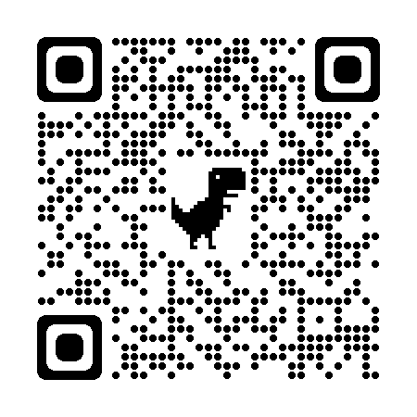
Contact
Information
Name:
Email:
More information at: OregonStudentAid.Gov

