Slide 1
Welcome to the
November MS Coordinator Connections
ASPIRE Family Engagement: Awareness/ Events/Presentations
ASPIRE Awareness
MS Family Events
ASPIRE Presentations
Notes:
WELCOME….
New Day in ASPIRE: Read Mission

Slide 2

ASPIRE Awareness
Staff/Student Awareness
New ASPIRE posters
ASPIRE Logos
https://oregonstudentaid.gov/resources/aspire-publications/
Notes:
This is only one of our new ASPIRE posters that you will be able to pick up today on the way out…other examples of our new posters and materials you can find in your Fall Conference Folders. Our ASPRE Posters speak directly to your students…encouraging them to be career and college ready…and as an ASPIRE Student:
READ Poster
Our other 3 new ASPIRE posters can be linked together to make 1 large poster that speaks to the all students no matter their future plans:
Students who are interested in college
Students who are interested in career and trades AND
Students who may not know yet what they want to do.
These posters can also be hung separately (One example might be to order some extra Career/trades posters to place in your Career Technical Education hallways)
This year we are bringing a new focus to ASPIRE Awareness…we want your staff, community, and especially your students to recognize that they are a part of something special. AS an ASPIRE Student they may:
Meet with a mentor,
Hear career or college presentations in their classrooms
Attend career or college events their MS, HS, or Community based organizations.
No matter the CCR Work you are doing at your site…Career College Readiness work you are doing falls under the ASPIRE umbrella and the work you do is extremely important because you are making a difference in the lives of students you serve.
- Encourage you to use the ASPIRE Logos on your programming event posters,

Slide 3
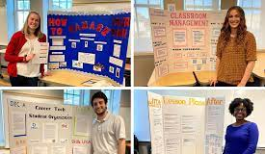
Elementary Science Fair Meets Career and College Exploration
Student Projects assigned in Advisory/homeroom or Core Class (English)
  Include Career information, education needed, identify college/trade school
Vote on best – raffle gift for winner
Provide presentation for families:
  Support for career and college exploration
  Community Service that relates
  Class choices: CTE Classes, core classes, electives,
MS Event Idea #1
Career & College Exploration
Notes:
New Oregonstudentaid.gov Website
New and improved and we are continuing to expand resources and we will materials through out the year!

Slide 4
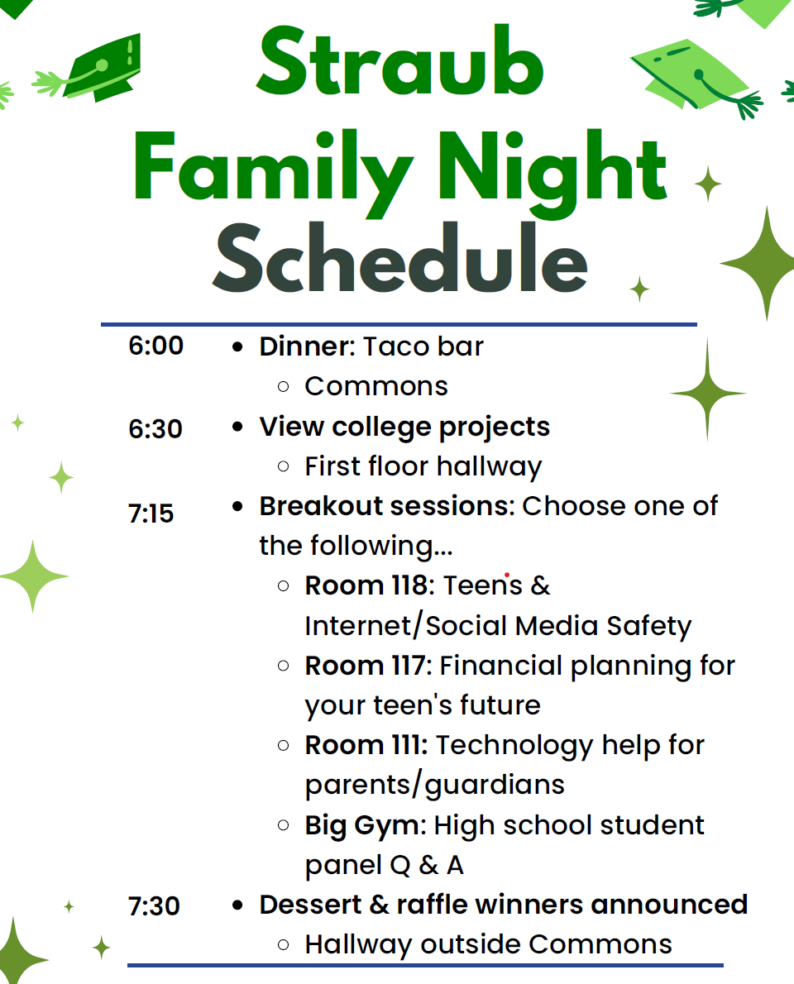

MS EVENT #2
Family Night
Notes:
New Oregonstudentaid.gov Website
New and improved and we are continuing to expand resources and we will materials through out the year!

Slide 5

MS Event Idea #3 8th Grade
Parent Night
Invite counselors/principal of HS to present
  CTE overview
  AP/Honors
  Graduation Requirements
  ASPIRE Coordinator from HS
    HS Student Panel “What I wish I would’ve known”
    Handouts with club/sports/activities offered at HS
Notes:
New Oregonstudentaid.gov Website
New and improved and we are continuing to expand resources and we will materials through out the year!

Slide 6

ASPIRE Parent Night Presentation – Outreach Request
Work in Progress:
Career/College Exploration
Preparing for College
  Understanding Financial Aid for college/trade schools
  Oregon College Savings Plan & Bottle Drop
  Building your Resume
    Activities Chart
    Community Service
    Extracurricular Activities
    Making the most out of your HS Experience: Classes, grades, attendance and activities
Notes:
New Oregonstudentaid.gov Website
New and improved and we are continuing to expand resources and we will materials through out the year!

Slide 7

What would you like to see?
Notes:
New Oregonstudentaid.gov Website
New and improved and we are continuing to expand resources and we will materials through out the year!

